Slide 1
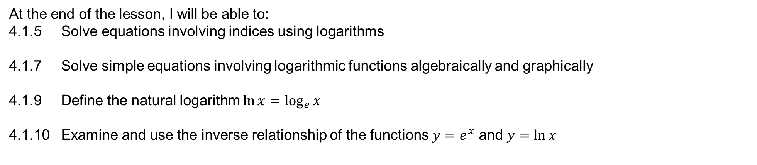
Learning Objective
I will be able to recognise the inverse relationships between logarithms and exponentials and use them to solve equations involving indices.
Success Criteria
At the end of the lesson, I will be able to:
4.1.5 Solve equations involving indices using logarithms
4.1.7 Solve simple equations involving logarithmic functions algebraically and graphically
4.1.9 Define the natural logarithm $\ln{x}=\log_{e}{x}$
4.1.10 Examine and use the inverse relationship of the functions $y=e^{x}$ and $y=\ln{x}$

Slide 2
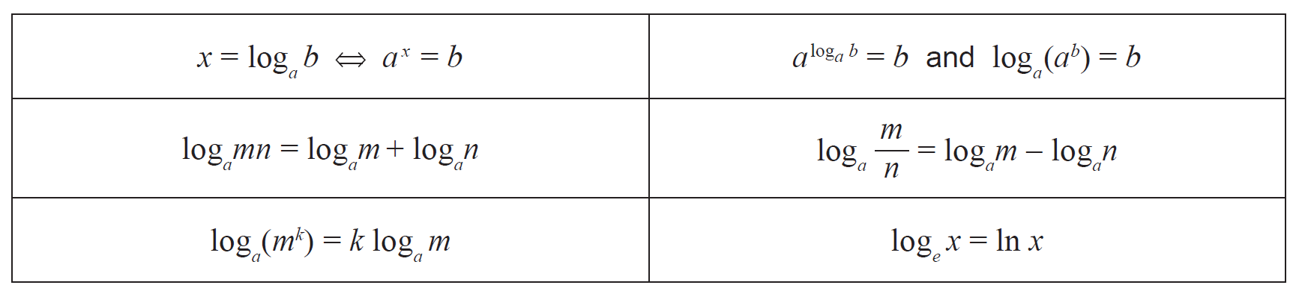



Laws of logarithm
In the formula sheet:
Inverse relationship between log and exponentials:
Law 7:
Law 1:
Law 2:
Natural logarithm:
Law 3:
Not in formula sheet:
Law 4: $\log_{a}{a=1}$
Law 5: $\log_{a}{1=0}$
Law 6: $\log_{a}{\frac{1}{x}}=−\log_{a}{x}$

Slide 3
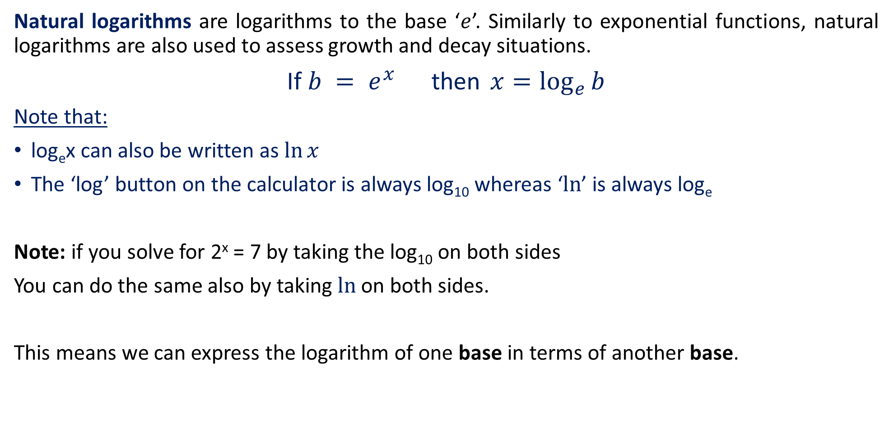
Natural Logarithms
Natural logarithms are logarithms to the base ‘$e$’. Similarly to exponential functions, natural logarithms are also used to assess growth and decay situations.
If $b = e^{x}$then $x=\log_{e}{b}$
Note that:
log_{e}x can also be written as $\ln{x}$
The ‘log’ button on the calculator is always log₁₀ whereas ‘$ln$’ is always log_{e}
Note: if you solve for 2^{x} = 7 by taking the log₁₀ on both sides
You can do the same also by taking $ln$ on both sides.
This means we can express the logarithm of one base in terms of another base.

Slide 4


Change of Base
If $x=\log_{a}{b}$then $ax = b$
Take log_{c} on both sides, where c is any other base value
$\log_{c}{(a^{x})}=\log_{c}{b}$
${xlog}_{c}{(a)}=\log_{c}{b}$
$x=\frac{\log_{c}{b}}{\log_{c}{a}}$
$\log_{a}{b}=\frac{\log_{c}{b}}{\log_{c}{a}}$

Slide 5
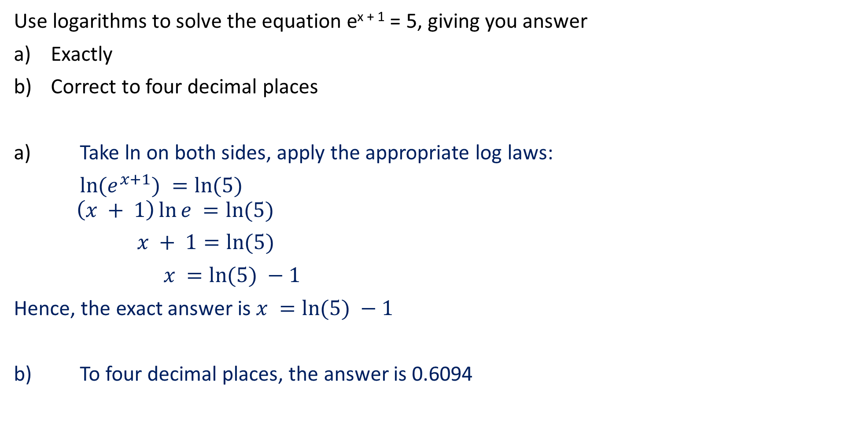
Guided Practice
Use logarithms to solve the equation e^{x + 1} = 5, giving you answer
Exactly
Correct to four decimal places
a) Take ln on both sides, apply the appropriate log laws:
$\ln{(e^{x+1})} =\ln{(5)}$ $\left(x + 1\right)\ln{e} =\ln{(5)}$
$x + 1=\ln{(5)}$
$x =\ln{(5)} −1$
Hence, the exact answer is $x =\ln{(5)} −1$
b) To four decimal places, the answer is 0.6094

Slide 6


Guided Practice
Use logarithms to solve the following equations exactly, and then to three decimal places:
a) e^{x} + e^{x + 1} = 250
b) e^{2x + 1} = 50^{x - 7}
a$) e^{x}(1 + e) = 250$
$e^{x}=\frac{250}{1+e}$
$\ln{(e^{x})}=\ln\left(\frac{250}{1+e}\right)$
$\left(x\right)\ln{(e)}=\ln\left(\frac{250}{1+e}\right)$
$x = ln⁡( \frac{250}{1+e} )$
Hence the answer to 3 d.p is $4.208$
b) $e^{2x+1}= {50}^{x−7}$
$$(2x + 1)ln⁡(e) = (x – 7)ln⁡(50)$$
$$2x + 1 = (x)ln⁡(50) – (7)ln⁡(50)$$
$$2x – (x)ln⁡(50) = −1 – (7)ln⁡(50)$$
$$x(2 – ln⁡(50)) = −1 – (7)ln⁡(50)$$
$$x = \frac{−1 – (7)ln(50) }{2 – ln(50)}$$
Hence the answer to 3 d.p. is 14.845

Slide 7

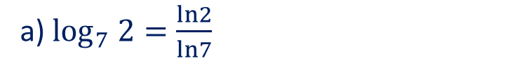
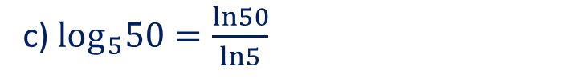
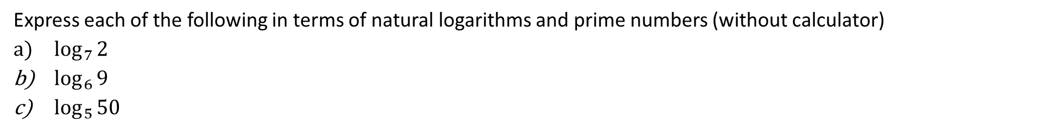



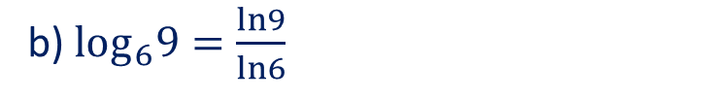

Guided Practice
Express each of the following in terms of natural logarithms and prime numbers (without calculator)
$\log_{7}{2}$
$\log_{6}{9}$
$\log_{5}{50}$
a) $\log_{7} 2=\frac{ln2}{ln7}$
c) $log_{5}50=\frac{ln50}{ln5}$
b) $log_{6}9=\frac{ln9}{ln6}$
$$=\frac{ln(25×2)}{ln(5)}$$
$$=\frac{ln3^{2}}{ln(2×3)}$$
$$=\frac{ln\left(5^{2}\right)+ln(2)}{ln(5)}$$
$$=\frac{2ln3}{ln\left(2\right)+ln (3)}$$
$$=\frac{2ln\left(5\right)+ln(2)}{ln(5)}$$

Slide 8
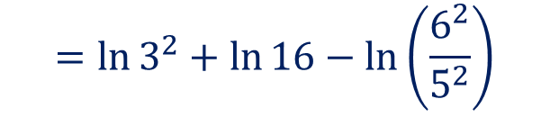
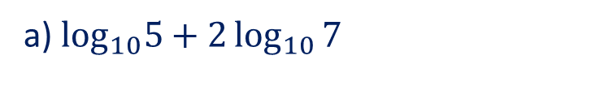
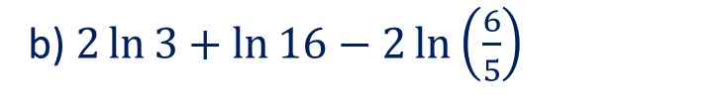

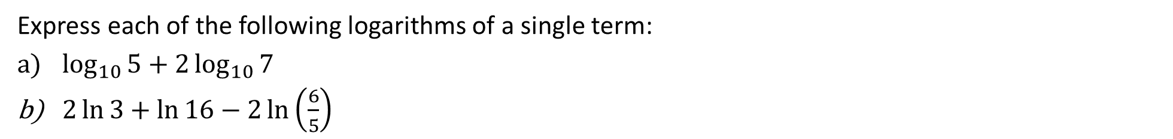
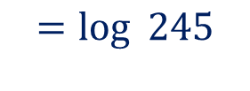


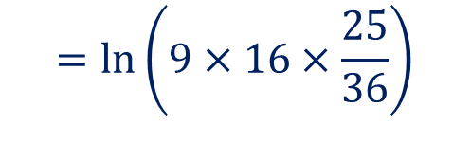
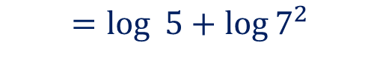
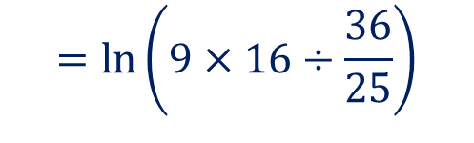
Guided Practice
Express each of the following logarithms of a single term:
$\log_{10}{5}+2\log_{10}{7}$
$2\ln{3}+\ln{16}−2\ln\left(\frac{6}{5}\right)$
a) $\log_{10}5+2\log_{10}{7}$
b) $2\ln{3}+\ln{16}−2\ln\left(\frac{6}{5}\right)$
$$=\log_{ }{5}+\log{7^{2}}$$
$$=\ln{3^{2}}+\ln{16}−\ln\left(\frac{6^{2}}{5^{2}}\right)$$
$$=\log_{ }{5×49}$$
$$=\log_{ }{245}$$
$$=\ln\left(9×16÷\frac{36}{25}\right)$$
$$=\ln\left(9×16×\frac{25}{36}\right)$$
$$=\ln\left(4×25\right)$$
$$=\ln\left(100\right)$$

Slide 9


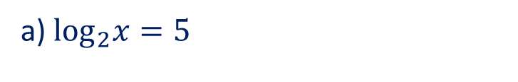
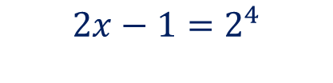

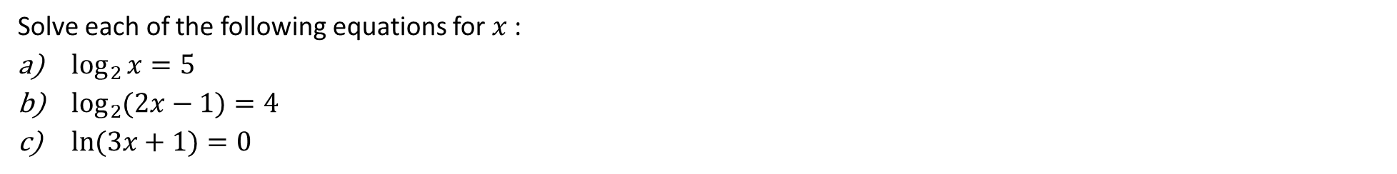
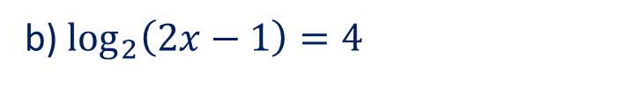


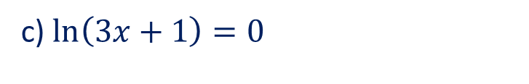


Guided Practice
Solve each of the following equations for $x$ :
$\log_{2}{x}=5$
$\log_{2}{(2x−1)}=4$
$\ln{(3x+1)}=0$
a) $\log_{2}x=5$
b) $\log_{2}\left(2x−1\right)=4$
c) $\ln\left(3x+1\right)=0$
$$x=2^{5}$$
$$2x−1=2^{4}$$
$$3x+1=e^{0}$$
$$x=32$$
$$2x=17$$
$$3x=1−1$$
$$x=\frac{17}{2}$$
$$3x=0⇒x=0$$

Slide 10



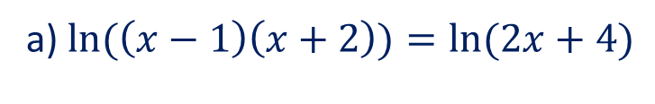
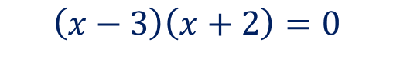

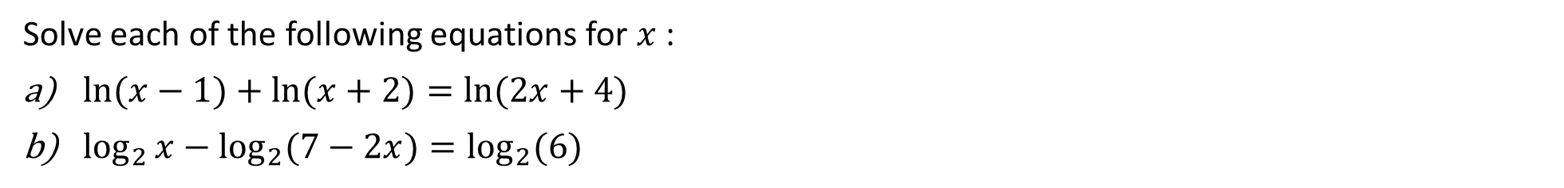


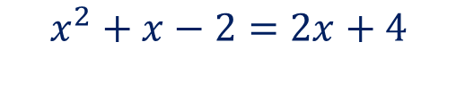

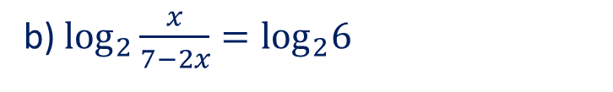
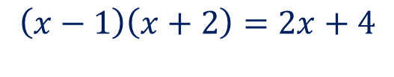
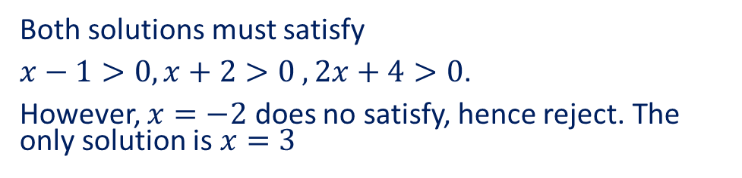

Guided Practice
Solve each of the following equations for $x$ :
$\ln{(x−1)}+\ln{(x+2)}=\ln{(2x+4)}$
$\log_{2}{x}−\log_{2}{(7−2x})=\log_{2}(6)$
a) $\ln{(\left(x−1\right)\left(x+2\right))}=\ln{(2x+4)}$
b) $\log_{2}{\frac{x}{7−2x}}=\log_{2}6$
$$\left(x−1\right)\left(x+2\right)=2x+4$$
$$\frac{x}{7−2x}=6$$
$$x^{2}+x−2=2x+4$$
$$x^{2}−x−6=0$$
$$x=6(7−2x)$$
$$\left(x−3\right)\left(x+2\right)=0$$
$$x=42−12x$$
$$x=3, x=−2$$
$$13x=42$$
Both solutions must satisfy
$x−1>0, x+2>0 , 2x+4>0$.
However, $x=−2$ does no satisfy, hence reject. The only solution is $x=3$
$$x=\frac{42}{13}$$

Slide 11
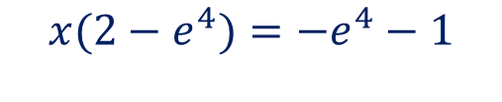

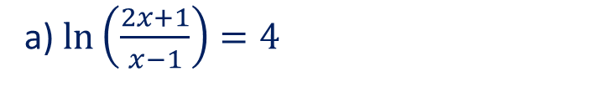
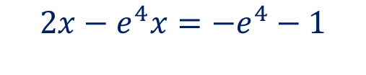

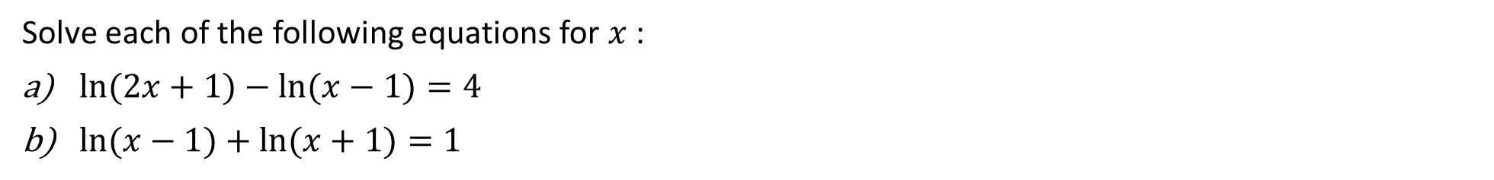
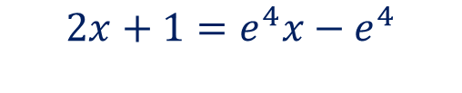

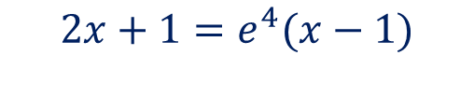
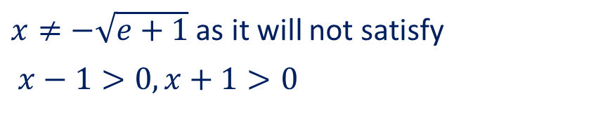
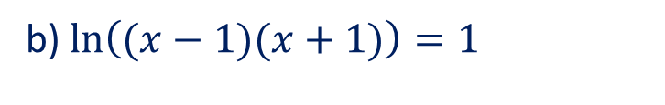
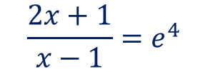
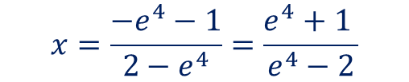

Guided Practice
Solve each of the following equations for $x$ :
$\ln{(2x+1)}−\ln{(x−1)}=4$
$\ln{(x−1)}+\ln{(x+1)}=1$
a) $\ln\left(\frac{2x+1}{x−1}\right)=4$
b) $\ln\left((x−1)(x+1)\right)=1$
$$\left(x−1\right)\left(x+1\right)=e^{1}$$
$$\frac{2x+1}{x−1}=e^{4}$$
$$x^{2}−1=e^{1}$$
$$2x+1=e^{4}(x−1)$$
$$x^{2}=e^{1}+1$$
$$2x+1=e^{4}x−e^{4}$$
$$x=±\sqrt{e+1}$$
$$2x−e^{4}x=−e^{4}−1$$
$$x(2−e^{4})=−e^{4}−1$$
$x≠−\sqrt{e+1}$ as it will not satisfy
$x−1>0, x+1>0$
$$x=\frac{−e^{4}−1}{2−e^{4}}=\frac{e^{4}+1 }{e^{4}−2}$$

Slide 12

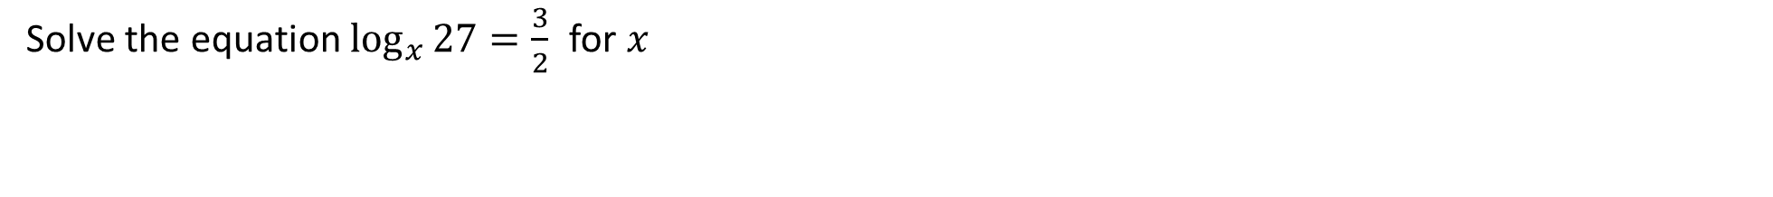



Guided Practice
Solve the equation $\log_{x}{27}=\frac{3}{2}$ for $x$
$$27=x^{\frac{3}{2}}$$
$$x^{\frac{1}{2}}={27}^{\frac{1}{3}}$$
$$x^{\frac{1}{2}}=3$$
$$x=3^{2}=9$$

Slide 13


Guided Practice
If P= 9e^{(t} ⁺ ¹⁾ find an exact expression for t in terms of P and evaluate it correct to three decimal places if rounding is necessary, for
P = 180
P = 3600
P = 9e³
$\frac{P}{9}=e^{t+1}$
$\ln\left(\frac{P}{9}\right)=(t + 1)ln⁡(e)$
$\ln\left(\frac{P}{9}\right)=t + 1$
$t =\ln\left(\frac{P}{9}\right) – 1$
t = ln ( $\frac{180}{9}$ ) – 1
t = 1.996
b) t = ln ( $\frac{3600}{9}$ ) – 1
t = 4.991
c) t = ln ( $\frac{{9e}^{3}}{9}$ ) – 1
t = 2

Slide 14


















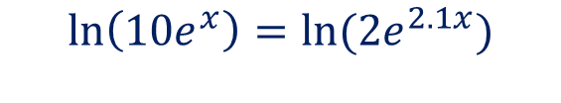


Guided Practice– 2018 Calc Free Paper
Solve exactly for $x$ in the following: (3 marks)
$$10e^{x}=2e^{2.1x}$$
Method 1:
Method 2:
$$\ln\left(10e^{x}\right)=\ln{(2e^{2.1x})}$$
$$\frac{10}{2}=\frac{e^{2.1 x}}{e^{x}}$$
$$\ln{10}+\operatorname{xln}{e}=\ln{2}+\left(2.1x\right)\ln{e}$$
$$\ln{10}+x=\ln{2}+2.1x$$
$$5=e^{1.1x}$$
$$2.1 x−x=\ln{10}−\ln{2}$$
$$\ln{5}=\ln{e^{1.1x}}$$
$$1.1x=\ln{\frac{10}{2}}$$
$$\ln{5}=1.1x\ln{e^{ }}$$
$$\frac{11}{10}x=\ln{5}$$
$$\ln{5}=\frac{11}{10}x$$
$$x=\frac{10\ln{5}}{11}$$
$$x=\frac{10\ln{5}}{11}$$

Slide 15
Independent Practice
Complete Cambridge Ex 2D

